Slide 1

COVID-19 MOBILITY REPORT
The Fish Touchers: Benny, Bill, Steven
Notes:
Bill: Hello Everybody, I am Bill
Benny: I am Benny
Steven: and I am Steven
Bill: Today, we will be showing you our Covid-19 Mobility Report and present our analysis we have accomplished in the past two weeks.

Slide 2
TABLE OF CONTENTS
01
02
03
CHANGE IN MOBILITY
EFFECTS ON SOCIETY
REFLECTION ON POLICIES
What causes them to change?
How do these statistical changes affect our world?
What could have been done better? Any lessons learned?
Notes:
Benny:
There are 3 topics that we are going to cover today. The first one is the change in mobility, we will be analyzing the changes using different charts and maps we have organized, as well as comparing the change in mobility rate within Canada and around the entire world. The second topic is the effects on society, we will be showing you our findings regarding how these trends and statistics can relate to different aspects of our world. And lastly, we will show you the conclusions we have made, and reflect on what the world could done better in response to the pandemic.
So now, let’s get right into it.

Slide 3
Change in Mobility
01
Notes:
Steven: Now, we will be talking about the change in mobility

Slide 4
The Arrival of a Pandemic (Ontario)
January 25, 2020
December 26, 2020
First Lockdown
Third Lockdown
First Case
Second Lockdown
March 17, 2020
April 1, 2021
Notes:
Steven: Before we get started, we want to take a look at the background of our pandemic. There are three total lockdowns in Ontario due to the increasing cases of Covid-19, since the spread of the virus can be significantly reduced by this preventive restriction. This is the direct cause of the change in the mobility rates which we will be analyzing.

Slide 5
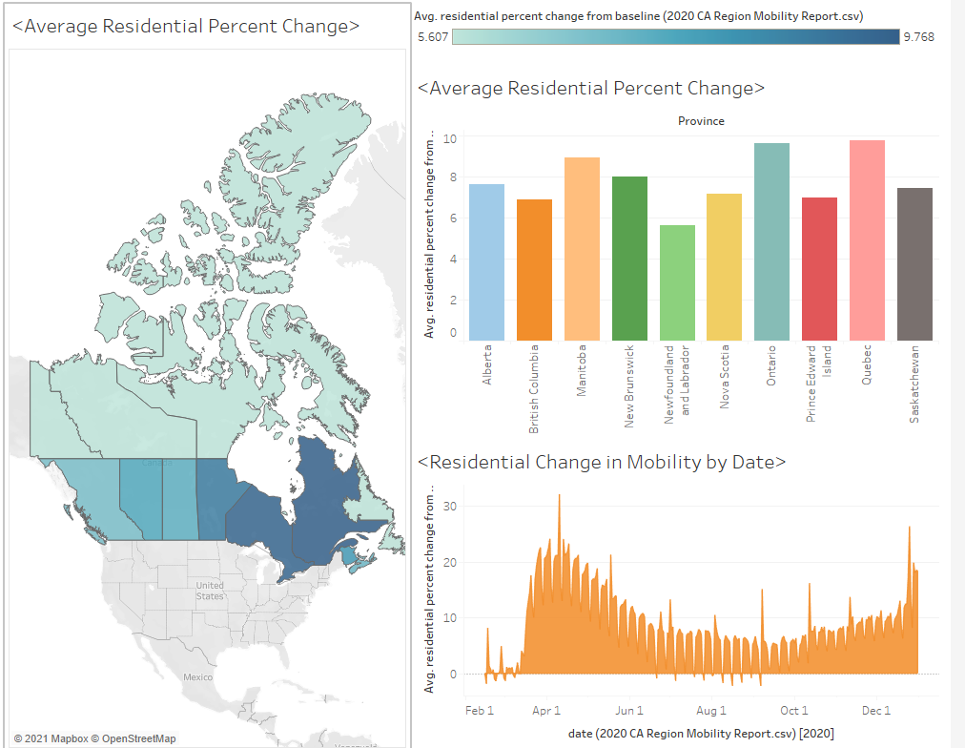
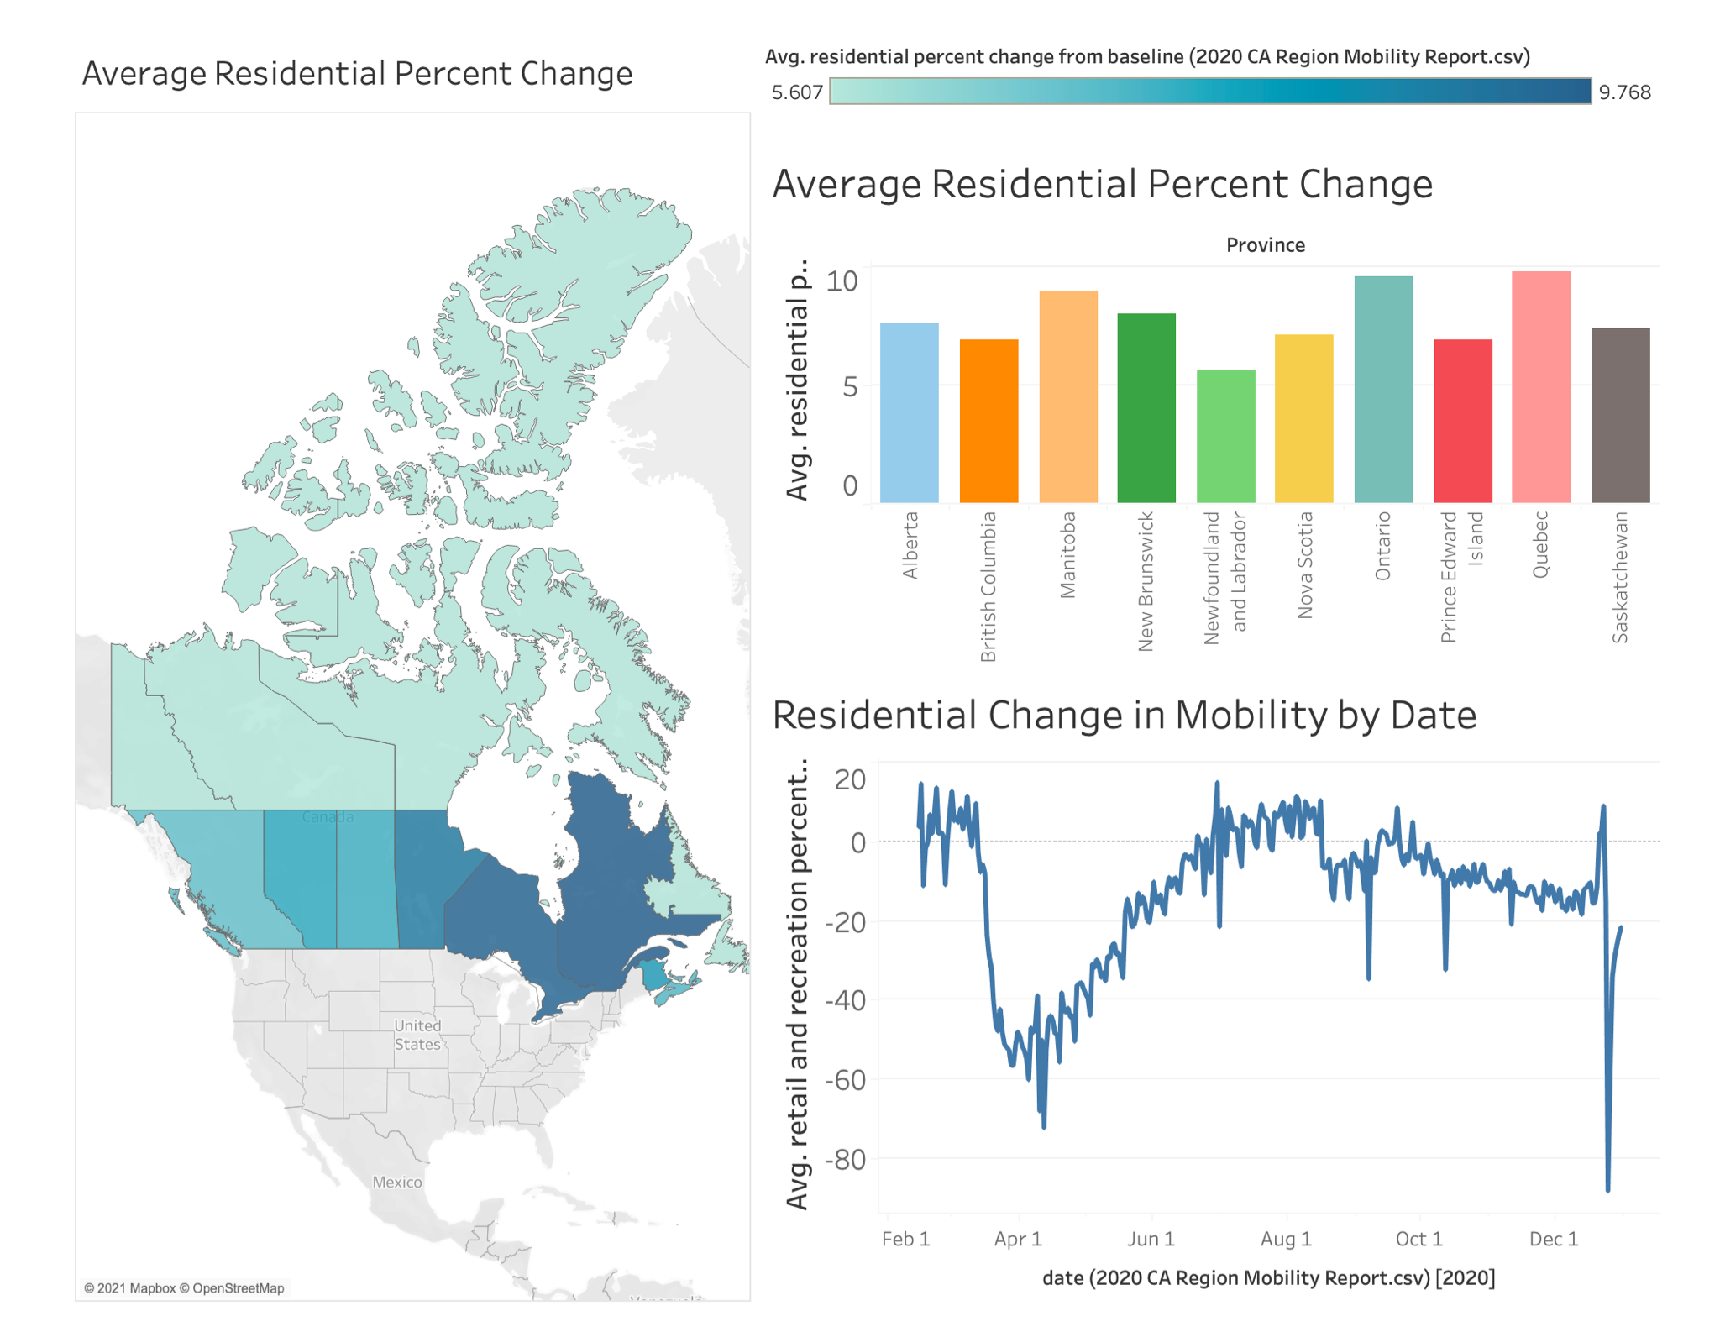
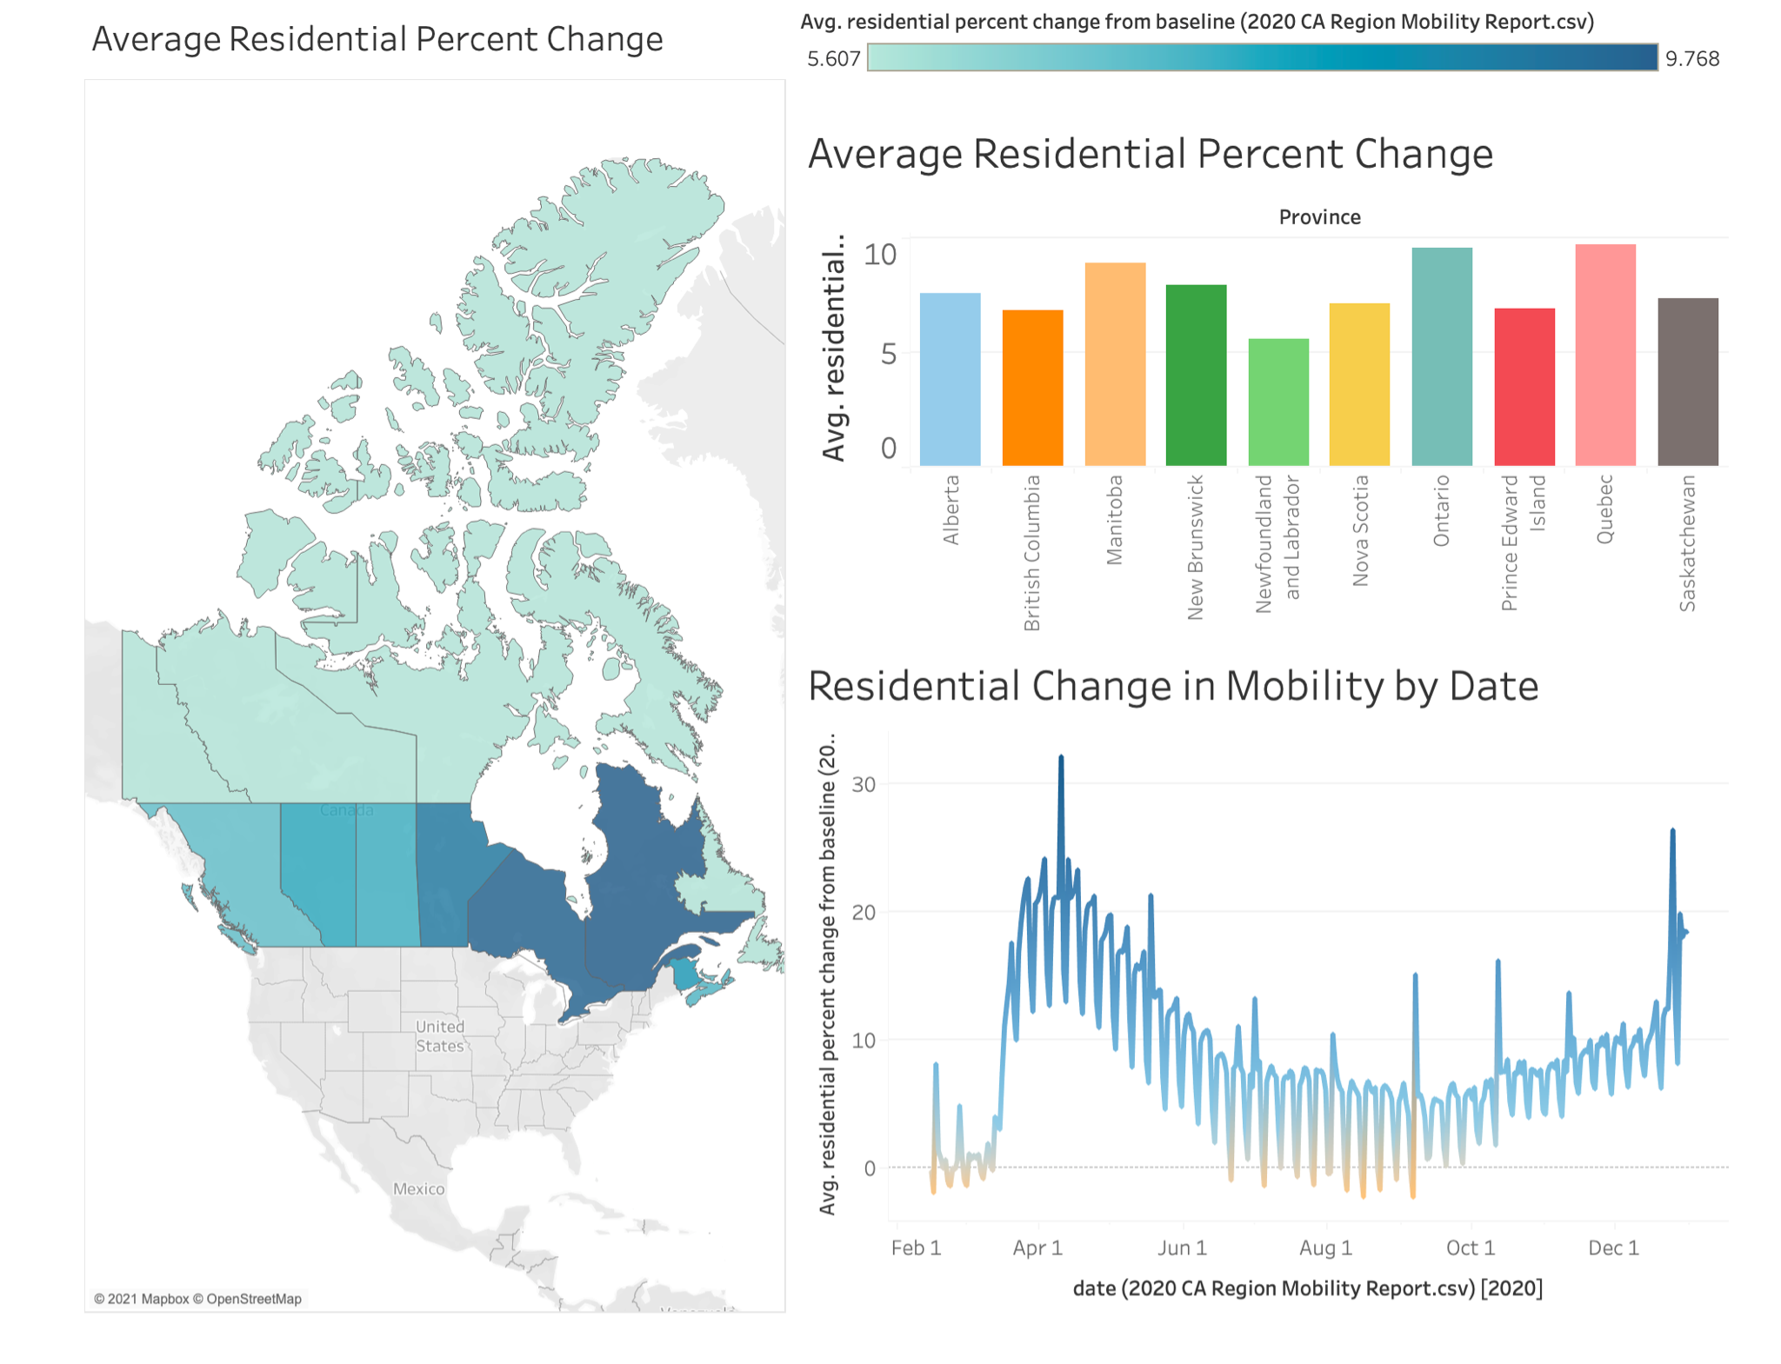
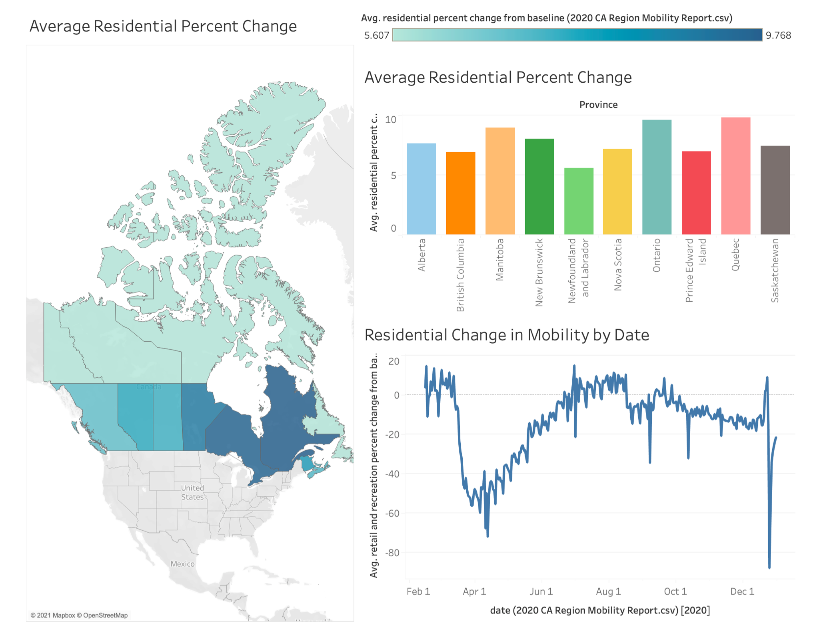
Mobility Change: Residential
Average Residential Percent Change
Average Residential Percent Change
Average Residential Percent Change
Canada
+5.607 (N.L.)
+9.768 (Ontario)
World:
- 2.23% (Vietnam)
+23.72% (Panama)
Notes:
Benny:
The first datatype is residential mobility change.
Many provinces began the first lockdown in about late March, which caused a significant increase in the number of people staying at home. This rate has been decreasing as covid restrictions ease, however, it did rebounded to around 15 percent later because of the second and third wave of the pandemic.
Bill: Furthermore, from the data that we have gathered, we find out that more populated provinces like Ontario and Quebec are the regions that experienced the most change from baseline, since the pandemic has hit them the hardest. Comparing to the others, these two provinces also imposed much stricter covid restrictions, which is also a major reason they have such a drastic increase, especially in the first and second wave.
In terms of worldwide, there is no surprise that the average residential mobility rate have all increased during the pandemic, since stay at home orders are literally imposed in every single country. This number even ranges up to 23.7% in Panama, a country in central America, which has also suffered badly from Covid-19

Slide 6
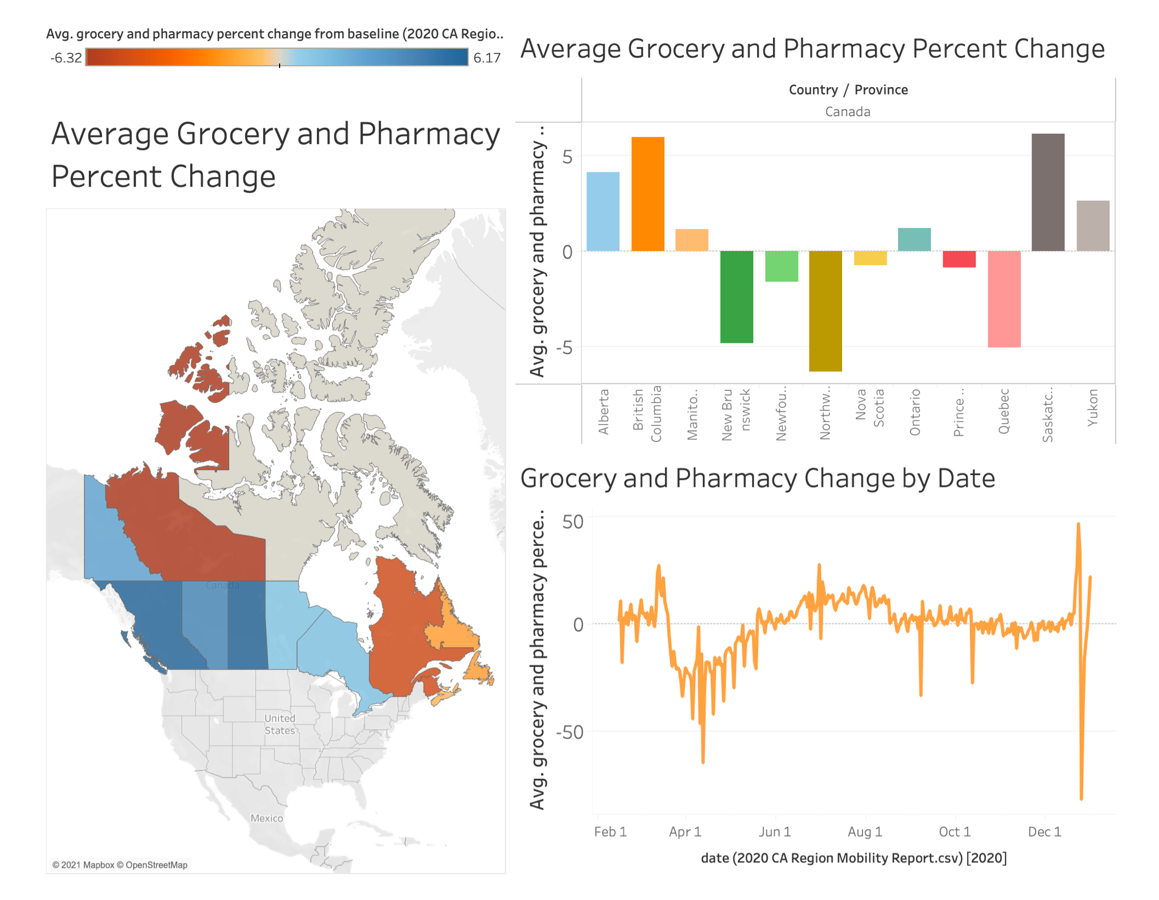
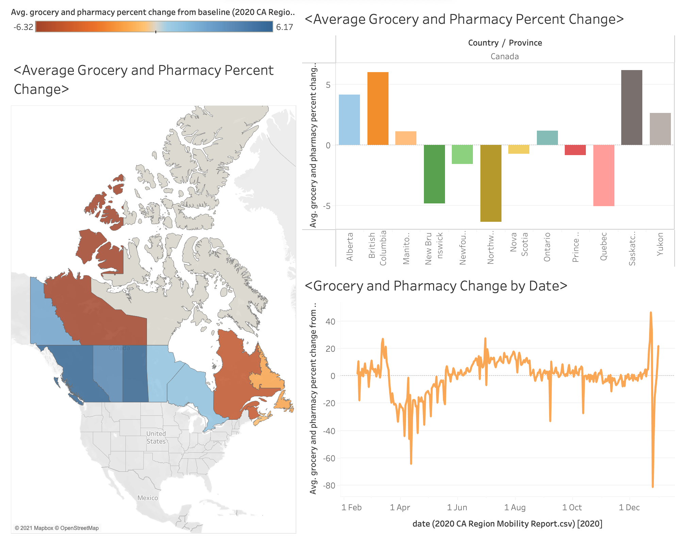
Mobility Change: Grocery & Pharmacy
Average Grocery & Pharmacy Percent Change
Canada
-6.32 (N.W.T.)
+9.768 (Saskatchewan)
World:
-32.67% (Panama)
+29.70% (Mongolia)
Notes:
Steven: When it comes to pharmacy and grocery, some provinces have an increase in mobility, and some provinces have a decrease. Provinces such as British Columbia and Saskatchewan had a slight increase of about 6%, while Quebec and NWT had a decrease of about 6%.
Benny: Even though there are certain outliers in the trend we see on the graph at the bottom right, such as Canada National Day and Christmas, the mobility rate has been hovering around the baseline throughout the second and third wave pandemic in major provinces of Canada.
Another statistics that might be interesting, is that the the percent change from baseline in all countries ranges from -30% to 30%. This is quite unbelievable, as we see that the grocery and pharmacy trend reacted in both ways dramatically, despite all having strict restrictions.

Slide 7
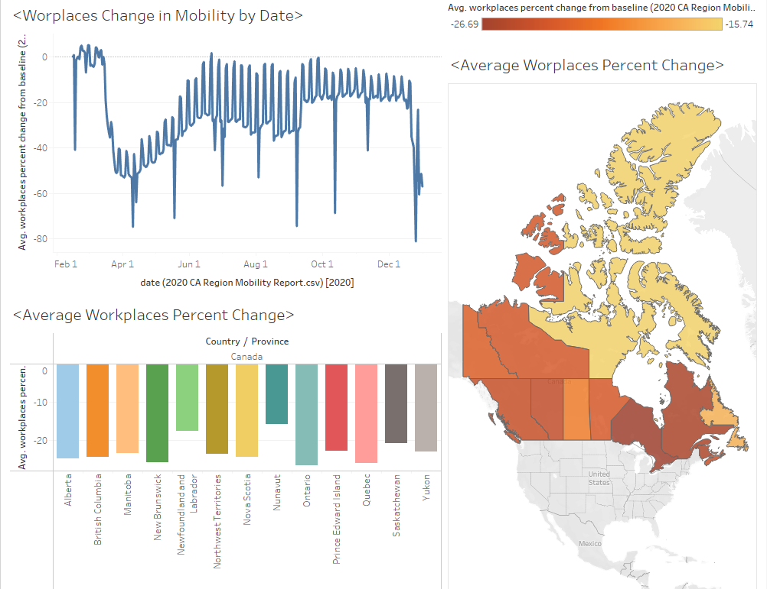
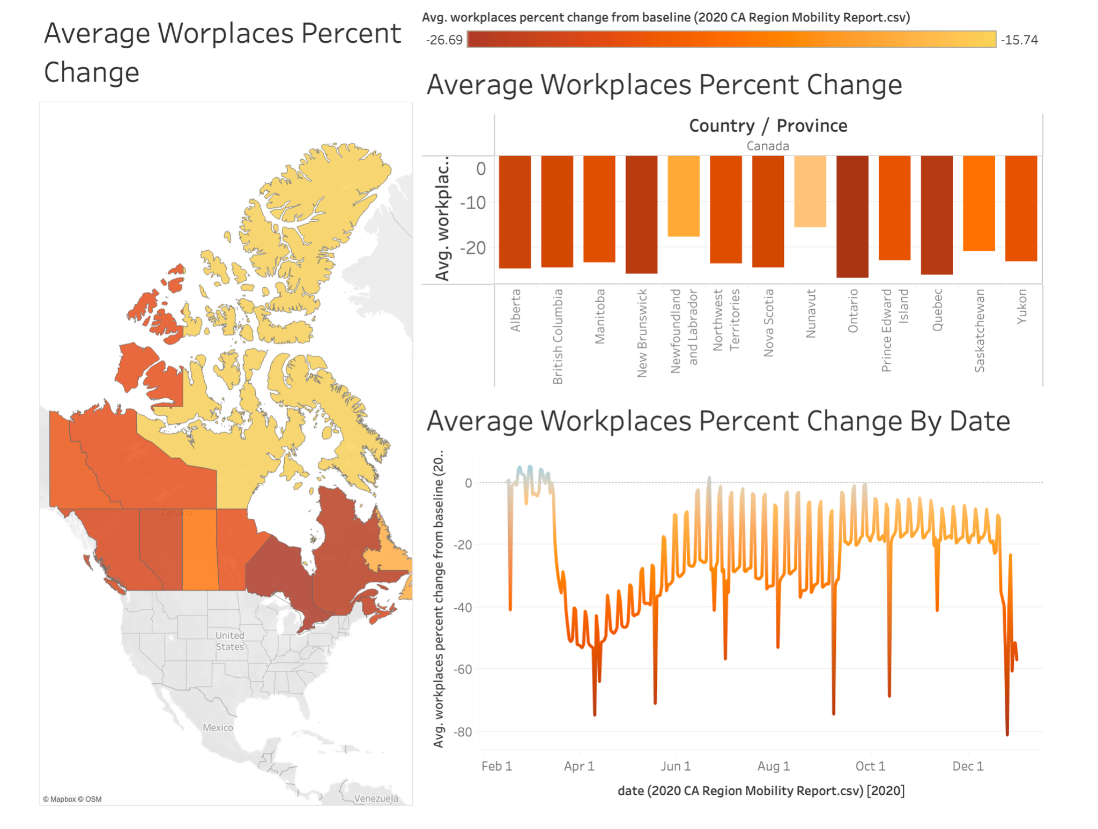
Mobility Change: Workplaces
Average Workplaces Percent Change
Canada
-15.7% (Nunavut)
-27% (Ontario)
World
-45.64% (Panama)
+6.68% (Papua New Guinea)
Notes:
Bill: During the pandemic, the workplace commuting related mobility suffered a constant drop across all the provinces, due to the closure of businesses and work at home practices.
You may notice that the data on the bottom right chart fluctuates up and down in a predictable manner, that’s because weekends would cause a temporary but significant change in data such as workplace mobility, causing the regular fluctuation.
Steven: Interestingly, you might notice that the trend we see here is exactly the opposite from the residential percent change from baseline, and it is also affecting similar provinces. For example, the significant hike in Residential mobility around late March translates to a large decrease here, and the lowest point took place during Christmas holidays. This might be confusing, but it is easy to understand, since the main reason why Canadians are forced to stay away from their workplaces is because of stricter covid restrictions, which is also a reason why people are spending significantly more time staying at home.
Benny: Furthermore, the countries that have the largest decline of workplace mobility are mainly in Europe. Similar to Canada, their inability to contain the virus, and a high possession rate to technologies, are the main reasons why people in these countries are still preferring remote working over going to work physically.

Slide 8
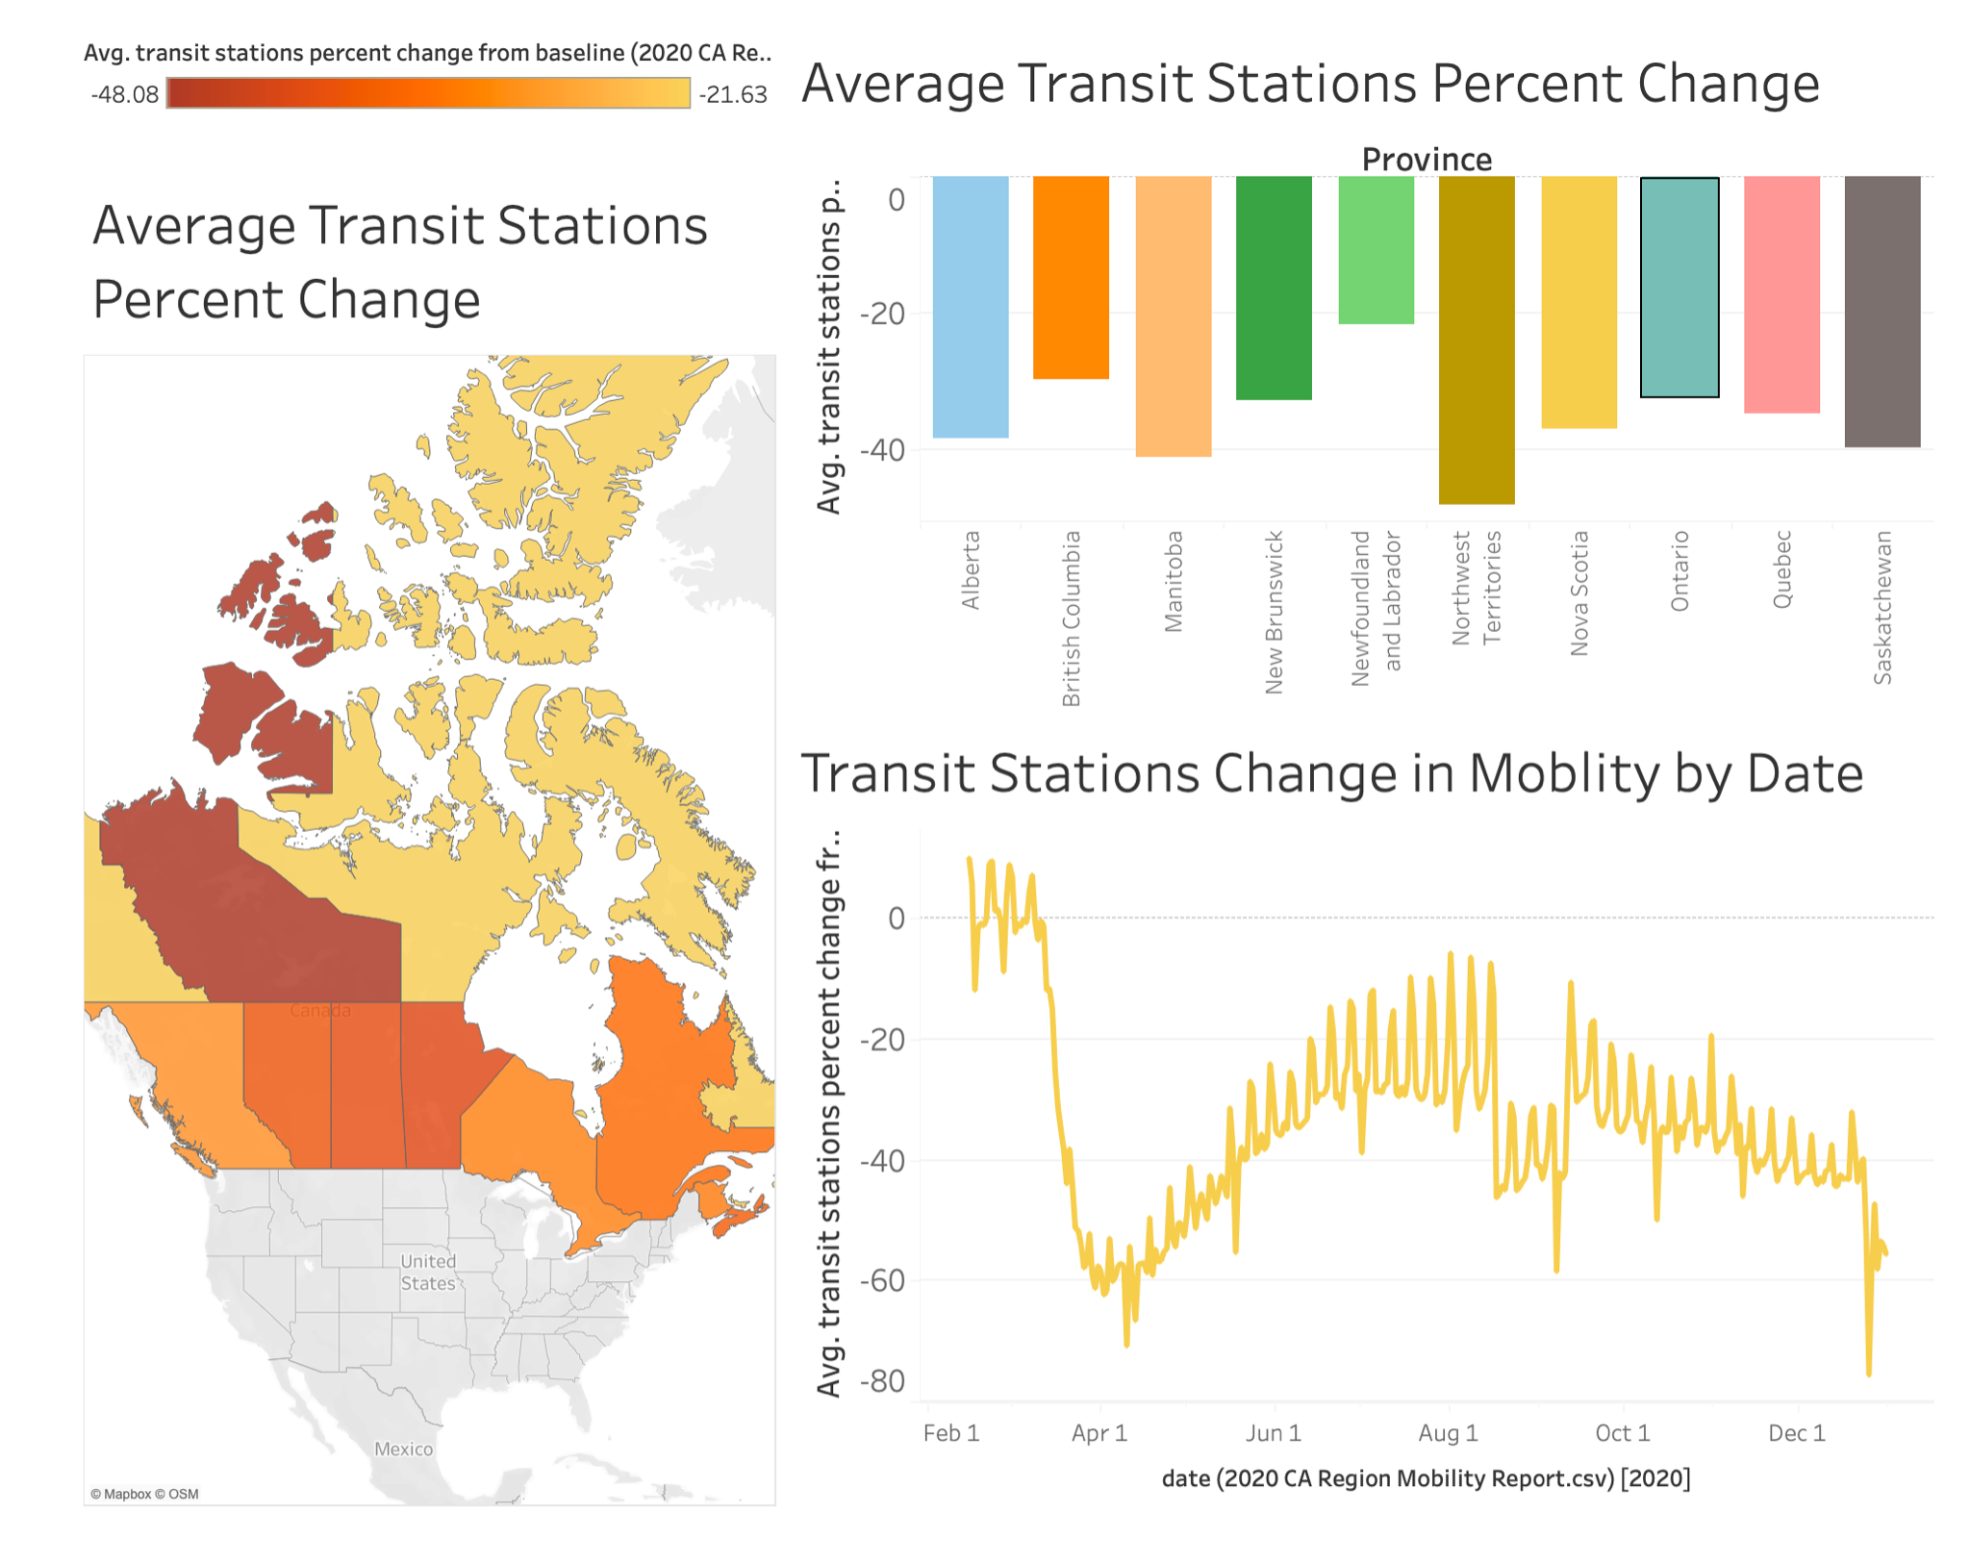
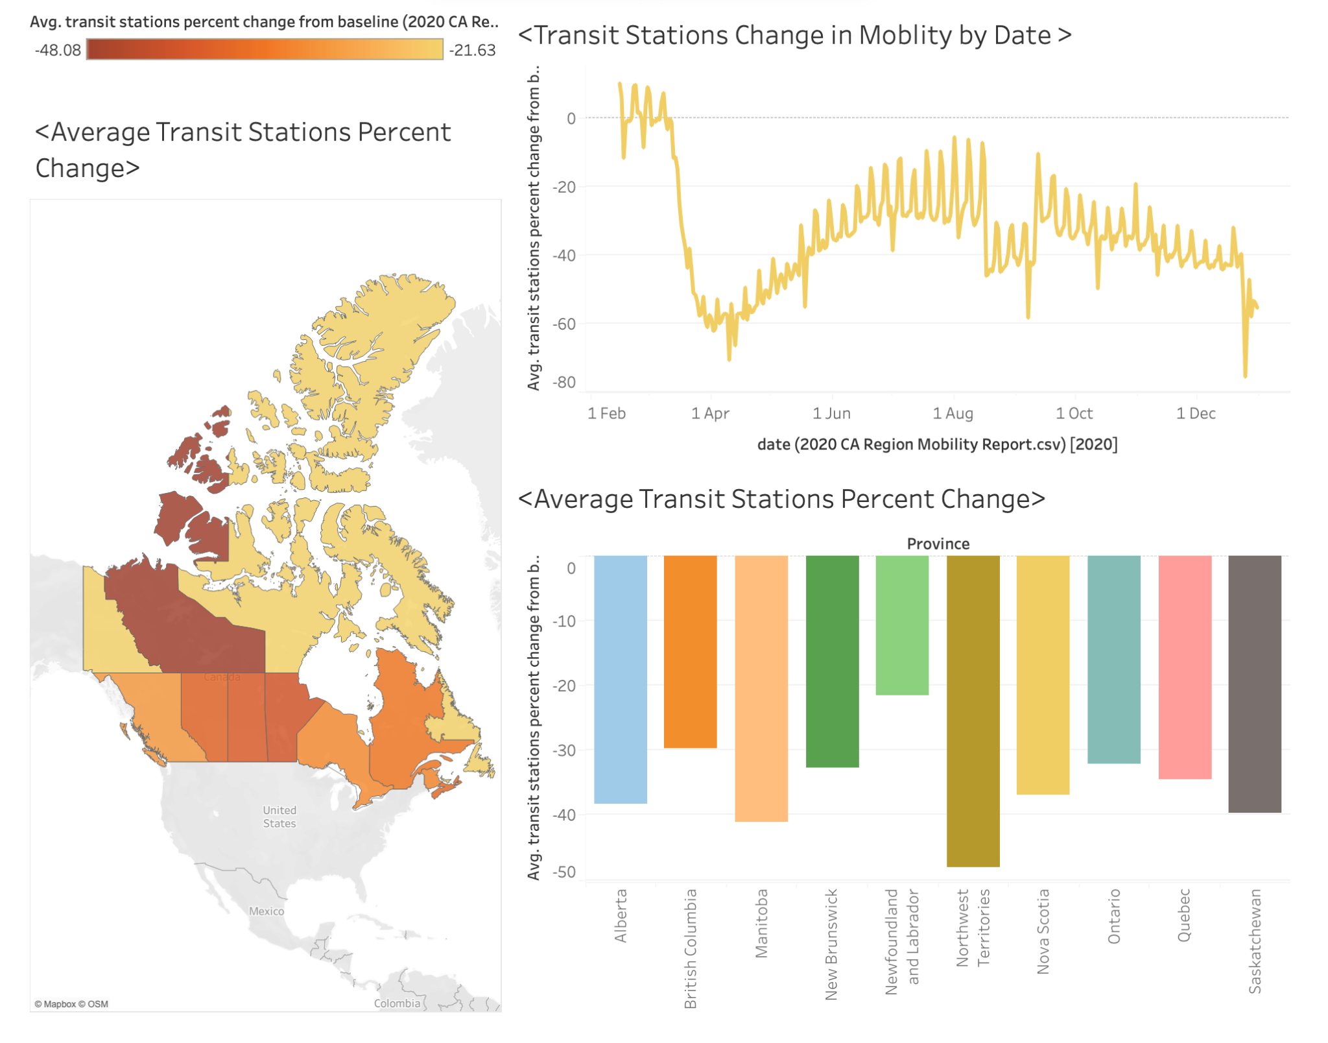
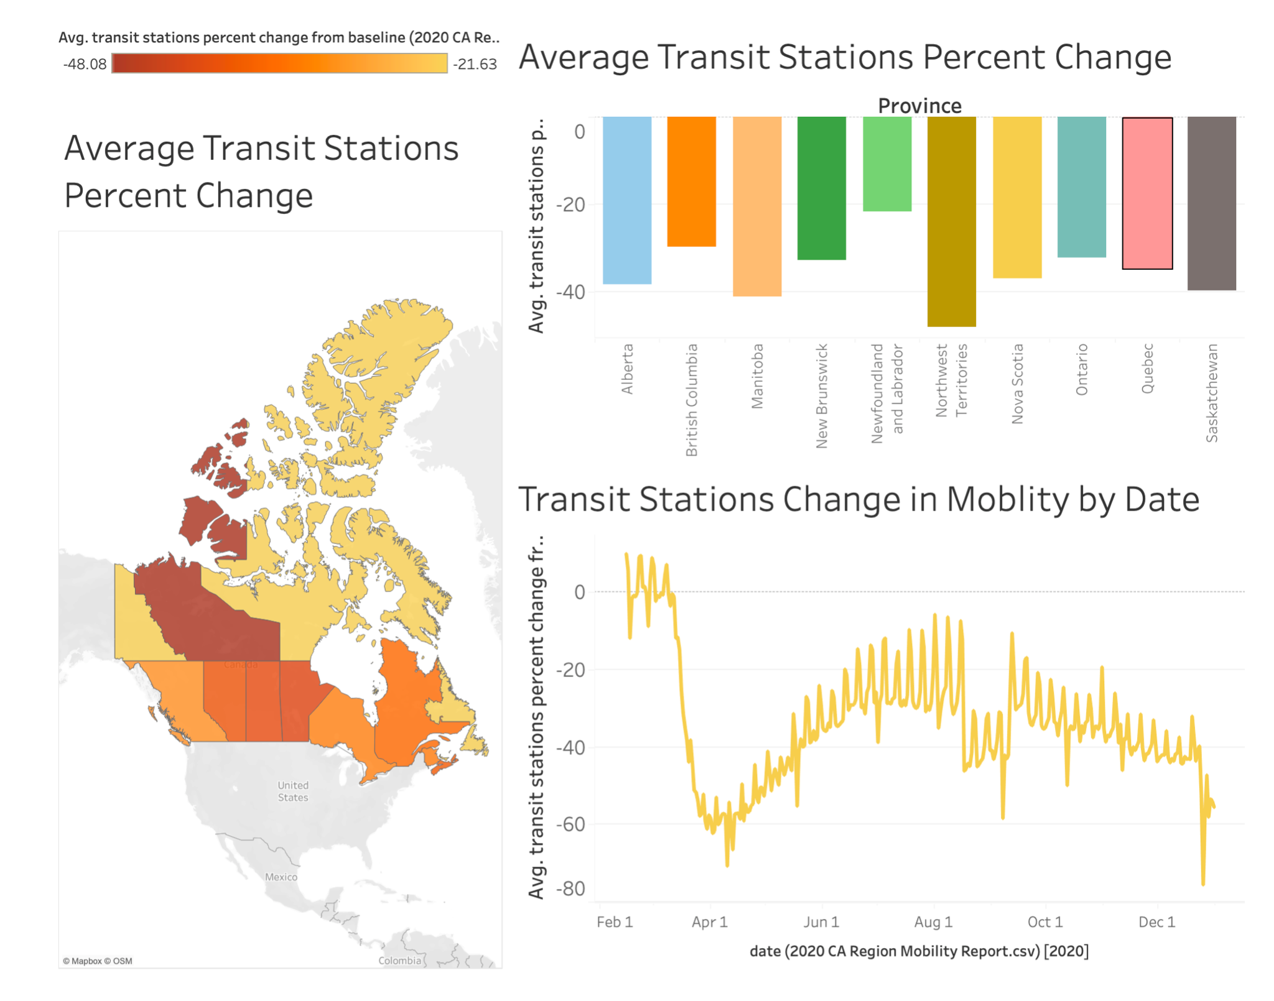
Mobility Change: Transit Stations
Average Transit Stations Percent change
Canada
-21.6% (N&L)
-48.1% (NWT)
World:
-62.44% (Cape Verde)
+11.51% (Kazakhstan)
Notes:
Benny: From the statistics that we have analyzed, all countries have had a huge transit mobility drop from baseline. Especially in South America, which have very high covid cases, countries like Argentina and Peru have a average drop of transit mobility rate to an astonishing 50% from the baseline.
Bill: It is no different in Canada, regions such as Northwest Territories also had a 50% decline from baseline. Because these places relied much more on tourism compared to the other provinces, their transit stations suffer more during the pandemic as huge amount of tourism is practically impossible during the pandemic.
Bill: Similarly, the top mobile countries in terms of transits, especially in South America, have also experienced a huge decline because of their reliance towards tourism.

Slide 9
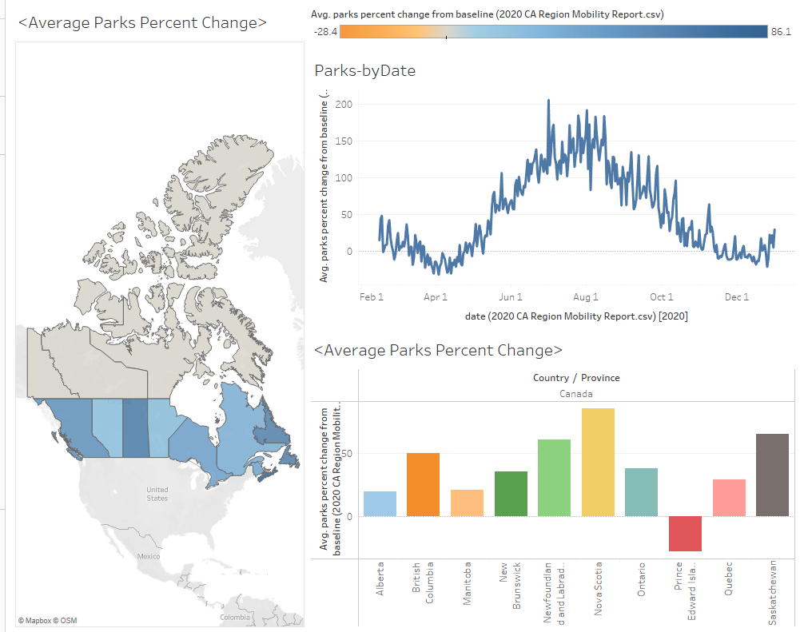
Mobility Change: Parks
Average Parks Percent Change
Average Parks Percent Change by Date
Canada
-28.4% (PEI)
+86.1% (Nova Scotia)
Average Parks Percent Change - Provinces
World
-62.6% (Argentina)
+75.8% (Denmark)
Notes:
Steven: Throughout the year, mobility to parks sees a dramatic increase compared to prior to the pandemic. Nova Scotia for example, sees as much as a 86% increase over baseline before the pandemic, and at one point the national statistic is more than three times as much over baseline. That is just insane.
Steven: Since travelling is forbidden during the pandemic, many individuals choose to go to their local parks for some fresh air instead, which explains the large increase. PEI is an exception among other provinces, having a decrease instead of increase. Being a tourism focused province, PEI parks usually sees many tourists visiting, which explains the exception.

Slide 10
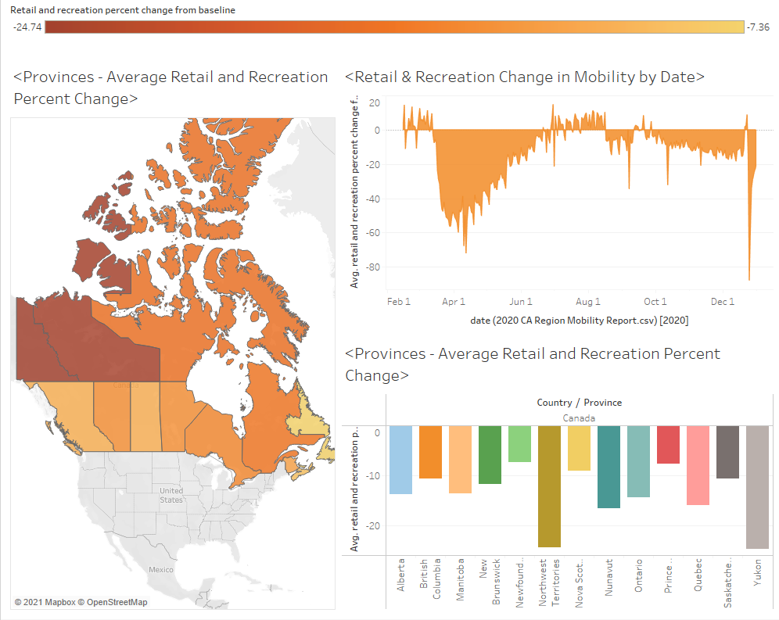
Mobility Change:
Retail &
Recreation
Canada:
-7.36% (N.L.)
-24.74% (Yukon)
Average Retail and Recreation Percent Change
Average Retail and Recreation Percent Change by Date
Average Retail and Recreation Percent Change by Province
World:
-32.67% (Panama)
+29.70% (Mongolia)
Notes:
Benny: Canada has an 15% average drop from baseline in terms of retail and recreation. On the other hand, the United States only has a 10% drop. How have they been doing better? Well, the U.S is capable for more medical supplies, a higher hospitalization capacity, as well as better lockdown procedures. They also reopened their economy earlier. These are some direct and indirect reasons why the U.S has a higher retail and recreation rate from baseline, resulting in a strong economic recovery.
Benny: Just like every other statistics, there are certain outliers here. Mongolia is the exception: because of their small population, they are able to contain the virus very well. This allowed them to even improve their retail and recreation mobility change.

Slide 11
Effects on Society
02
Notes:
Bill: That is a lot of data that we have analyzed. Now, we will be talking about the effects on society

Slide 12

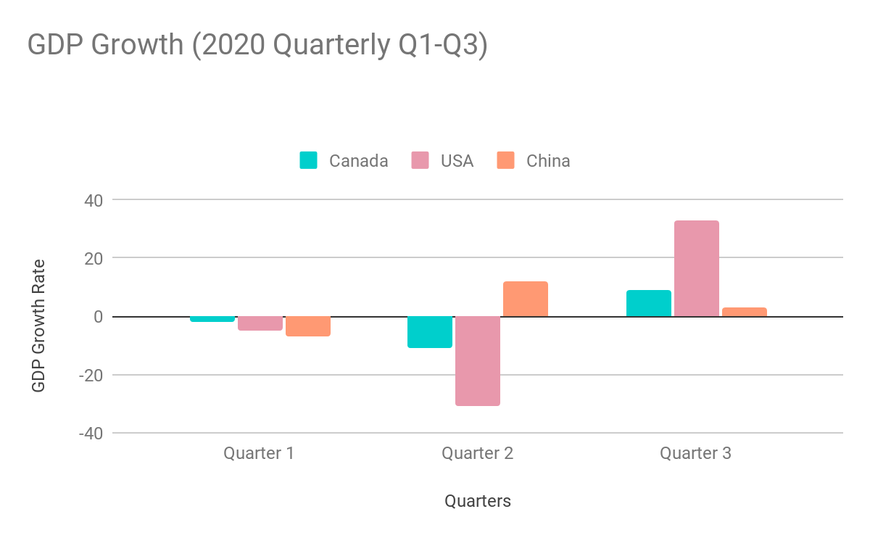
Effects On the Economy
Notes:
Bill: The graph shown above represents the GDP growth in the three quarters of 2020 for Canada, USA and China. As we can see, in the first two quarters of 2020, the U.S. economy entered recession due to the COVID-19 pandemic.The decline in second quarter GDP reflected the response to COVID-19, as "stay-at-home" orders issued in March and April were partially lifted in some areas of the country in May and June. This led to rapid shifts in activity, as businesses and schools continued remote work and consumers and businesses canceled, restricted, or redirected their spending.
-How is this related to the mobility change?
https://inequality.org/great-divide/updates-billionaire-pandemic/

Slide 13
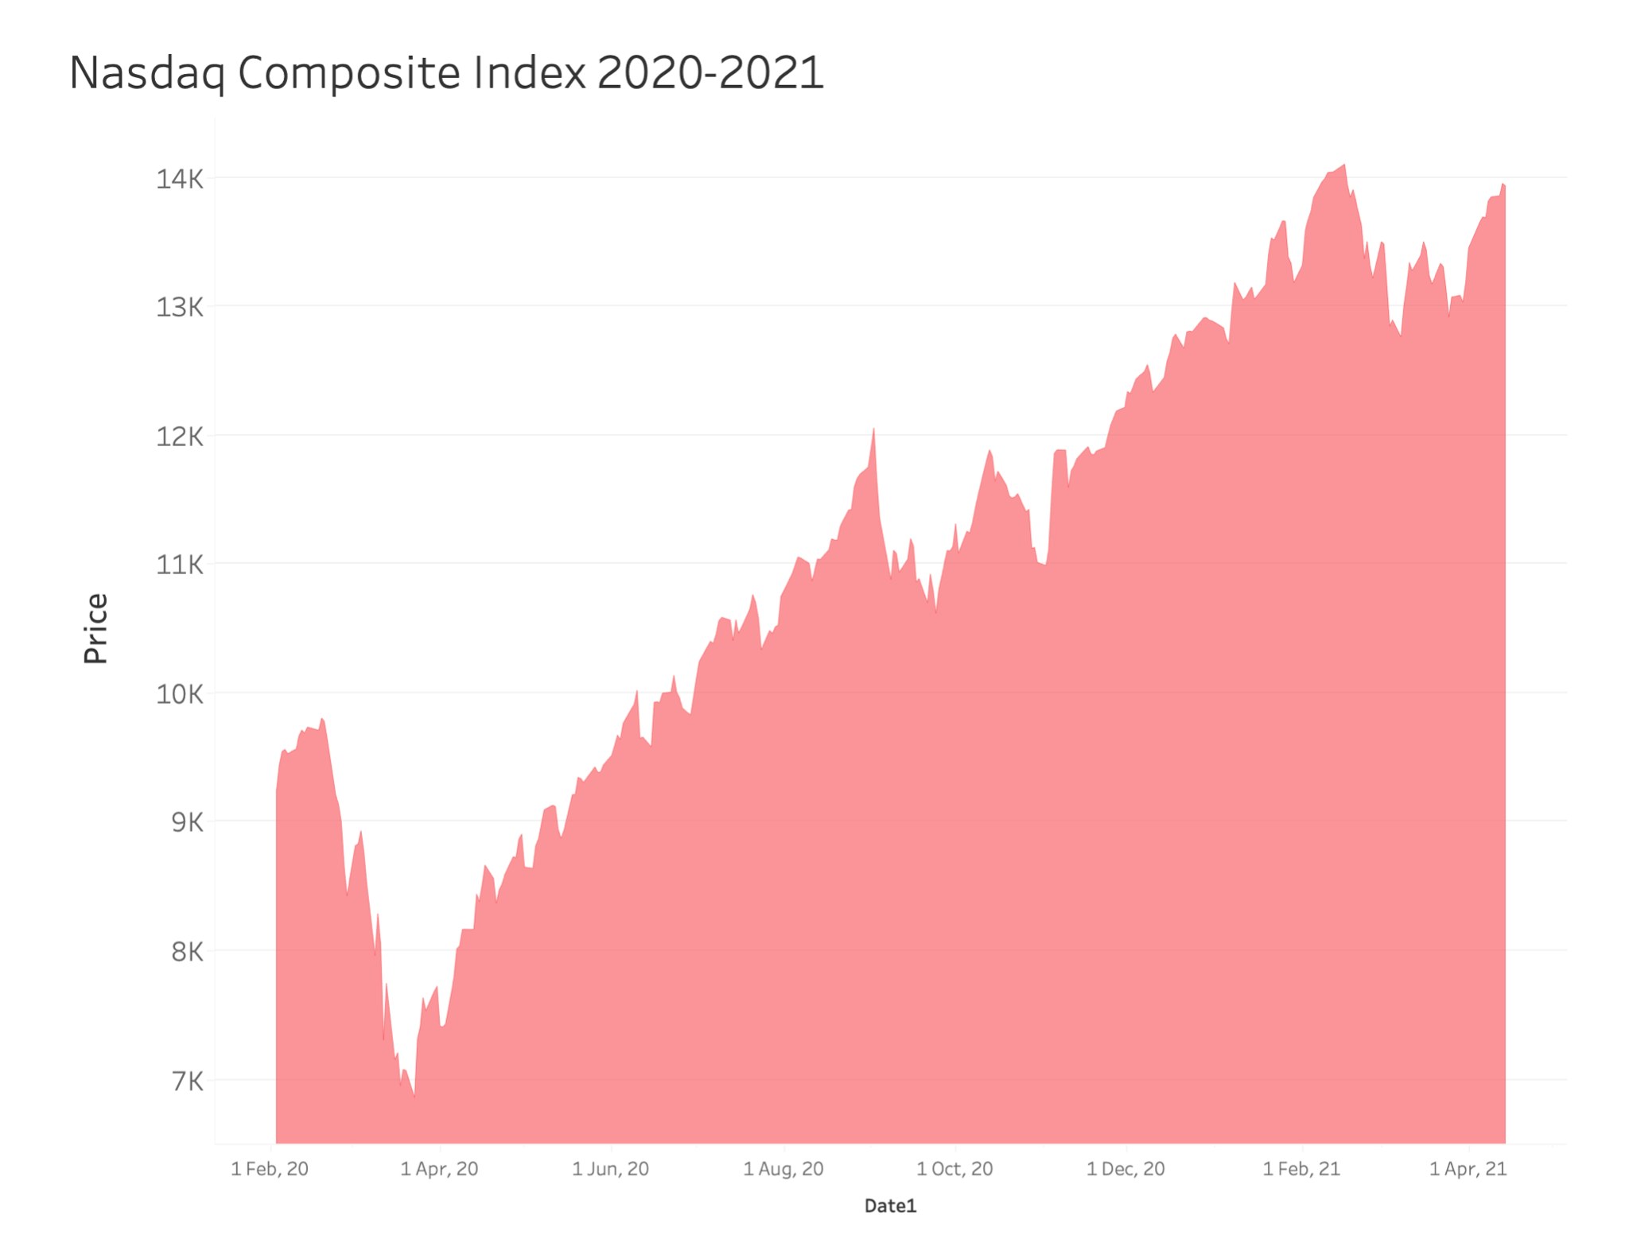
Effects on the Stock Market
As covid restrictions lift, and the overall mobility rate increases, the confidence of a strong economic recovery is shown in the stock market
2020 Stock Market Return
15.8%
43.2%
9.7%
S&P 500
Nasdaq
Dow Jones
Industrial
Notes:
Benny: Despite having a pandemic, the stock market has been surging throughout the past 12 months. The Nasdaq Composite even experiences an astonishing 43.2% in the year 2020.This is affected by a low interest rate as well as a ongoing recovery of the mobility rate - Businesses are reopening, and people are having more confidence towards a healthy reopening.
Benny: With the overall mobility rate increasing currently, we would only expect the stock market to continue this trend in the near future.

Slide 14
Reflection
03
Notes:
Steven: Now, we will be talking about our reflection toward the change of mobility

Slide 15
$1,300,000,000,000
Billionaires’ wealth increase in the US
Notes:
Steven: Guess the amount of dollars do the billionaires’ wealth increase in the US. 1.3 trillion dollars!

Slide 16

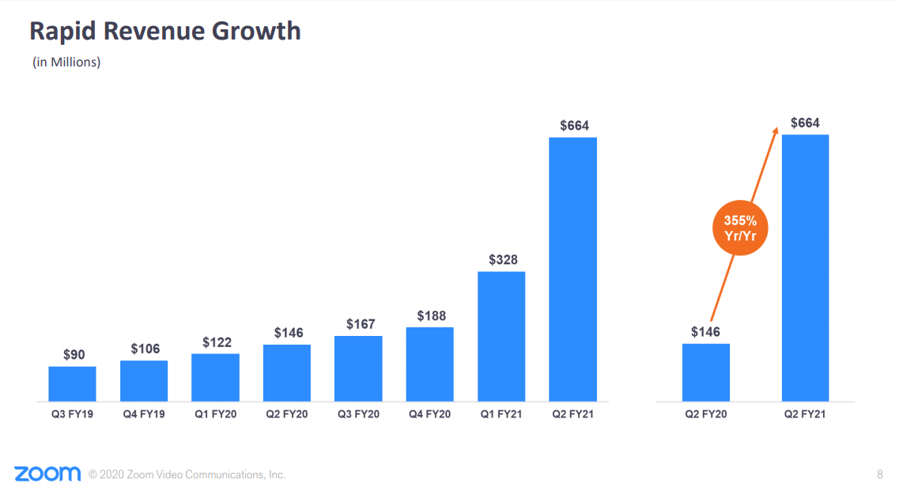
Reflections
Stricter Lockdown Measures results in better mobility rate bounce backs
Big tech companies benefit from a decrease in face to face businesses (Instacart, Amazon, social media companies…)
Notes:
Bill

Slide 17
CITATION
https://www.google.com/covid19/mobility/
https://inequality.org/great-divide/updates-billionaire-pandemic/
https://finance.yahoo.com/quote/%5EIXIC/history?p=%5EIXIC
https://tradingeconomics.com/canada/gdp-growth

Slide 18

THANKS
fish.toucher@yingshi.com
+1 (123) 456-7890
yingshi/fishtocuher.com

